Slide 1
ECE 333 Green Electric Energy
Lecture 15: Wind as a Resource
Dr. Karl Reinhard
Dept. of Electrical and Computer Engineering
University of Illinois at Urbana-Champaign
reinhrd2@illinois.edu

Slide 2
Announcements
No Homework / Quiz today
Homework 7 Posted (Economics and Wind)
Quiz 7 Thursday after Spring Break (29 Mar)
Reading Chapter 7
Thanks to EOH Volunteers – GREAT SUCCCESS
Spring Break Safety !!

Slide 3
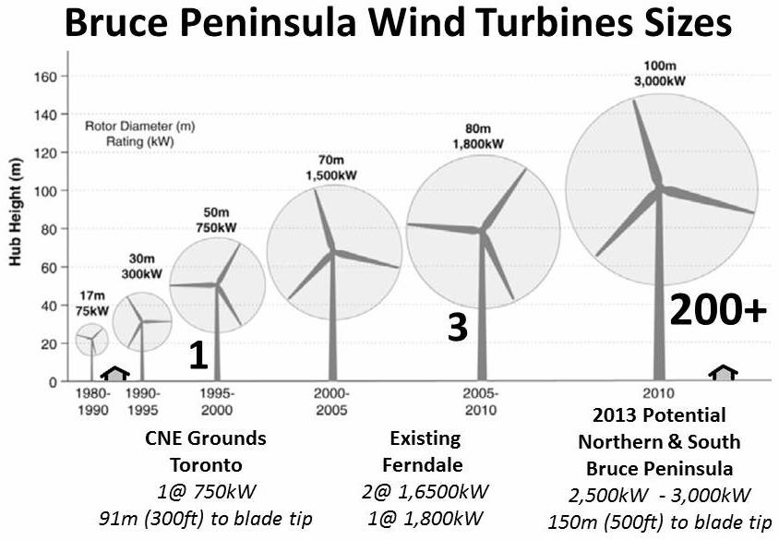
Wind Turbine Sizes
A 747 wing span is about 60m;
The Washing- ton mon- ument is
169m high
http://www.bpwtag.ca/Bruce%20Peninsula%20Wind%20Turbine%20Sizes%202013.jpg

Slide 4
Power in the Wind
Consider the kinetic energy of a small air “volume” with mass m moving at constant velocity v
m
v
Power in the wind (P_{w} )
constant v
A
m
v
constant A
Notes:
3

Slide 5
Power in the Wind (cont)
A
m
v
P_{W} (Watts) = power in the wind
ρ (kg/m³) = air density (1.225kg/m³ at 15˚C and 1 atm)
A (m²) = the cross-sectional area that wind passes through
v (m/s) = windspeed normal to A (1 m/s = 2.237 mph)
Fundamental relationship to be used throughout subsequent work !!
Notes:
4

Slide 6
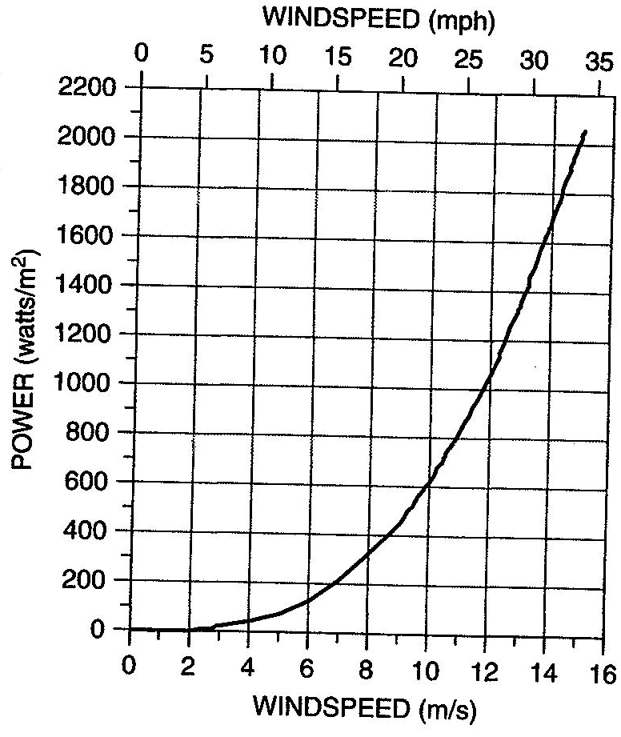
Power in the Wind (cont)
Power increases $∝v^{3}$
2 · v → 8 · P_{w}
Energy in 20 mph winds @ 1 hr = Energy in 8 mph winds @ 8 hr
Nonlinear, so we cannot use average wind speed
For comparison, summer solar is about 600 $\frac{W}{m^{2}}$
Notes:
5

Slide 7
Power in the Wind (cont)
P_{w} $∝$A
For a conventional HAWT, A = (π/4) D² → P_{w} $∝$blade diameter squared
Co$t is somewhat proportional to blade diameter
This in part explains why larger wind turbines are more co$t effective (plus, as we shall see, because they are higher, the winds are stronger)
Notes:
6

Slide 8
Example: Wind Energy Passing though 1 m²
100 hours of 6 m/s winds
50 hours of 3 m/s winds and 50 hours of 9 m/s winds - *the average wind speed is 6 m/s
Don’t use average wind speed!
Notes:
7

Slide 9
Air Density $∝$ Temperature and Pressure
Ideal gas Law
Air density is greater at lower temperatures
For example, in comparing 90º F (305º K) to 10º F (265.3º K), ratio is about 1.15:1
Notes:
8

Slide 10
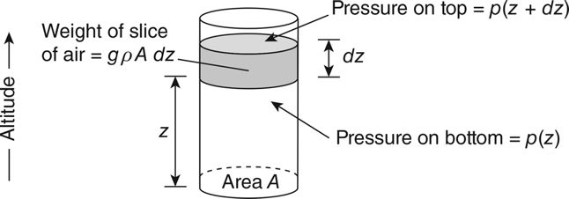
Air Density Altitude Correction
FIGURE 7.15 A column of air in static equilibrium used to determine the relationship between air pressure and altitude.
Masters, Gilbert M. Renewable and Efficient Electric Power Systems, 2nd Edition.
We get a differential equation in terms of pressure:
where H is in meters
Notes:
9

Slide 11
Air Density Temperature and Altitude Impacts
Density variation wrt temperature and altitude is given by
If z = 0 and T = 273.16 + 15, then ρ = 1.225 kg/m³
If z = 200 and T = 273.16 + 35, then ρ = 1.225 kg/m³ 1.120 (about 91% of sea level, 15 degree C value)
Notes:
10

Slide 12
Elevation & Terrain Roughness Impacts on P_{w}
Since power increases with the cube of wind speed, we can expect a significant economic impact from even a moderate increase in wind speed
There is a lot of friction in the first few hundred meters above ground – smooth surfaces (like water) are better
Wind speeds are greater at higher elevations – tall towers are better
Forests and buildings slow the wind down a lot
Notes:
11

Slide 13
Elevation & Terrain Roughness Impacts on P_{w}
α = friction coefficient – given in Table 6.3
v = wind speed at height H
v₀ = wind speed at height H₀ (H₀ is usually 10 m)
Typical open terrain α = 1/7
Large city, α = 0.4;
Small town, α = 0.3;
High crops, α = 0.2,
Calm water or hard ground, α = 0.1
Notes:
12

Slide 14
Elevation & Terrain Roughness Impacts on P_{w}
Alternative formulation (used in Europe)
l is the “roughness length” – given in Table 7.2
Note that both equations are just approximations of the variation in wind speed due to elevation and roughness
the best thing is to have actual local measurements
Notes:
13

Slide 15
Elevation & Terrain Roughness Impacts on P_{w}
Combining earlier equations we get
The other constants in the power in the wind equation are the same, so they just cancel:
Notes:
14

Slide 16
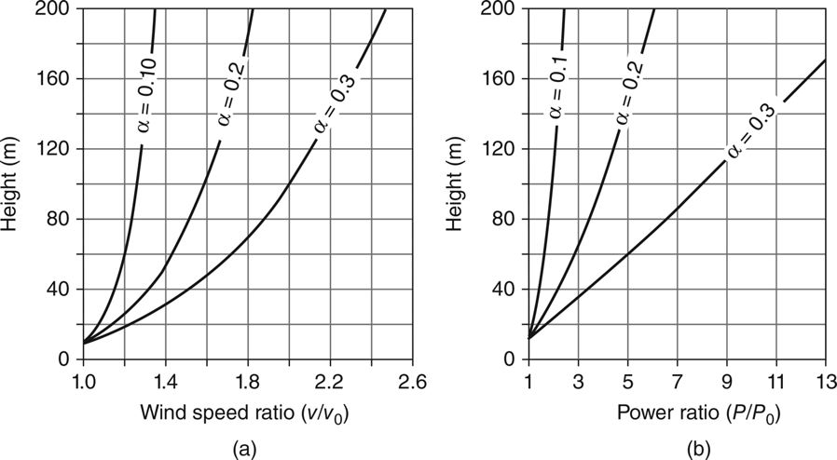
Elevation & Terrain Roughness Impacts on P_{w}
FIGURE 7.16 Increasing wind speed (a) and power ratios (b) with height for various friction coefficients α using a reference height of 10 m.
Masters, Gilbert M. Renewable and Efficient Electric Power Systems, 2nd Edition.
For a small town, windspeed at 100 m is twice that at 10 m
Areas with smoother surfaces have less variation with height
Notes:
15

Slide 17
Example: Rotor Stress Estimate
Wind turbine with hub at 50-m and a 30-m diameter rotor, α = 0.2
Find the ratio of power in the wind at highest point to lowest point
Power in the wind at the top of the blades is 45% higher!
65 m
50 m
35 m
Picture may not be to scale
Notes:
16

Slide 18
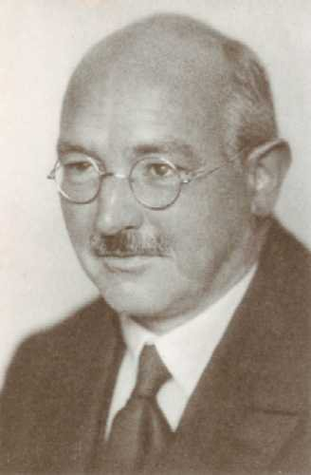
Maximum Rotor Efficiency – Betz’s Law
Two extreme cases, and neither is consistent with our intuition
Downwind velocity is zero – turbine extracted all of the power
Downwind velocity is the same as the upwind velocity – turbine extracted no power
The maximum power point lies between the extremes
Albert Betz (1885 – 1968), German physicist
Graduated 1910 from Technical University of Berlin w/ naval engineering degree.
Earned PhD in 1919 for his work on “Ship Propellers with Minimum Loss of Energy”
Betz' law states that, independent wind turbine design, no more than 16/27 (or 59%) of wind’s kinetic energy can be converted to mechanical energy.
https://alchetron.com/Albert-Betz

Slide 19
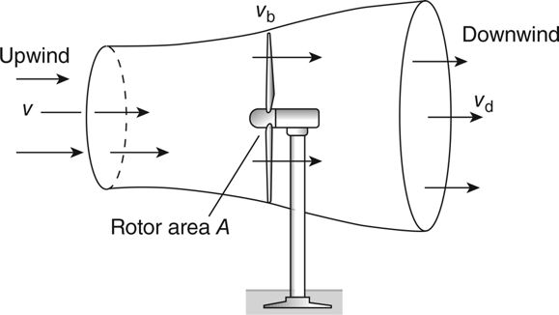
Maximum Rotor Efficiency – Betz’s Law
Constraint on the ability of a wind turbine to convert kinetic energy in the wind into mechanical power
Consider the wind passing though a turbine – it slows and the pressure is reduced so it expands
FIGURE 7.17 Approaching wind slows and expands as a portion of its kinetic energy is extracted by the wind turbine, forming the stream tube shown.
Masters, Gilbert M. Renewable and Efficient Electric Power Systems, 2nd Edition.

Slide 20
Power Extracted by The Blades
ṁ = mass flow rate of air within stream envelop
v = upwind undisturbed wind speed
v_{d} = downwind wind speed
The wind power converted to mechanical power is the difference between upwind and downwind airstream powers
Easiest to determine at the plane of the rotor because we know the cross sectional area A
Then, the mass flow rate is

Slide 21
Wind Mass Flow Rate
Assume the velocity through the rotor v_{b} is the average of upwind velocity v and downwind velocity v_{d}
Recall
Then
Define
Then substituting for v_{d} to get the power extracted
Opening Argument

Slide 22
Power Extracted by the Blades
P_{W} = Power in the wind
C_{P} = Rotor efficiency

Slide 23
Maximum Rotor Efficiency
Find the wind speed ratio λ that maximizes the rotor efficiency, C_{P}
From the previous slide
Set the derivative of rotor efficiency to zero and solve for λ:
maximizes rotor efficiency

Slide 24
Maximum Rotor Efficiency
Plug the optimal value for λ back into C_{P} to find the maximum rotor efficiency:
The maximum efficiency of 59.3% occurs when air is slowed to 1/3 of its upstream rate
Called the “Betz efficiency” or “Betz’ law”

Slide 25
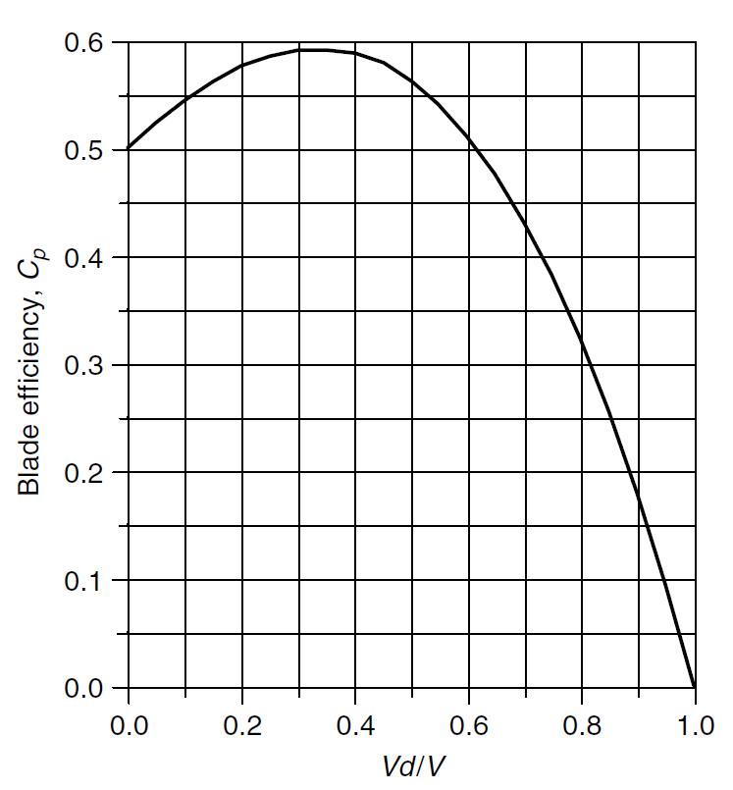
Maximum Rotor Efficiency
Rotor efficiency C_{P} vs. wind speed ratio λ
FIGURE 6.10 The blade efficiency reaches a maximum when the wind is slowed to 1/3 of its upstream value.
Masters, Gilbert M. Renewable and Efficient Electric Power Systems, 1st Edition

Slide 26
Tip-Speed Ratio (TSR)
Efficiency is a function of how fast the rotor turns
Tip-Speed Ratio (TSR) is the speed of the outer tip of the blade divided by wind speed
D = rotor diameter (m)
v = upwind undisturbed wind speed (m/s)
rpm = rotor speed, (revolutions/min)
One meter per second = 2.24 miles per hour

Slide 27
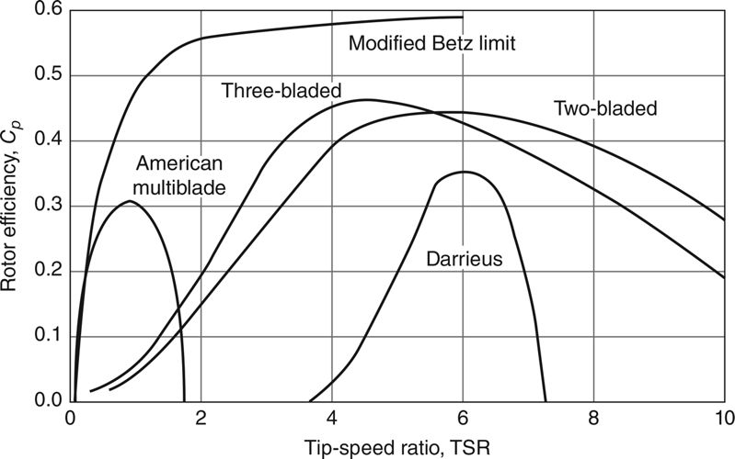
Tip-Speed Ratio (TSR)
TSR for various rotor types
blade turns too slow → wind passes through without hitting blade;
too fast → turbulence
FIGURE 7.18 Rotors with fewer blades reach their optimum efficiency at higher rotational speeds.
Masters, Gilbert M. Renewable and Efficient Electric Power Systems, 2nd Edition
Rotors w/ fewer blades reach their maximum efficiency at higher tip-speed ratios

